Slide 1
Mail-Order Pharmacy
“MFPE’s Feedback and Takeaways”
By:- Mansi Verma (849376)
Saurabh Mehra(849377)
Shivam Singh(849382)
Vikas Pandey(849385)

Slide 2
Our Responsibilities
Saurabh Mehra:- Authorization Microservice, UI and testing.
Vikas Pandey:- Drugs Microservice and it’s testing.
Mansi Verma:- Subscription Microservice and it’s testing.
Shivam Singh:- Refill Microservice and it’s testing.

Slide 3
Acknowledgement
We did the project(Mail Order Pharmacy) for our MFPE under the continuous guidance of
Mentor:- Sakthikumar Mahalingam
Trainer:- Shrivalli Maheshwaran
We would like to thank them for the continuous support.
With Regards,
Mansi Verma (849376)
Saurabh Mehra(849377)
Shivam Singh(849382)
Vikas Pandey(849385)

Slide 4
Project overview
A leading Pharmaceutical Benefits Management (PBM) Organization wants to develop a Mail-Order Pharmacy module using Microservices..
Mail-order pharmacies operate through your health insurance plan and can be cheaper and more convenient than getting your medications from a local pharmacy. A “mail-order” prescription means that you don’t have to pick up your medication from a pharmacy; instead, it is delivered to your doorstep.
There will also be a Member Portal to be developed part of this scope that consumes these Microservices. The Portal allows its members to subscribe for drugs refill, also to unsubscribe, etc

Slide 5
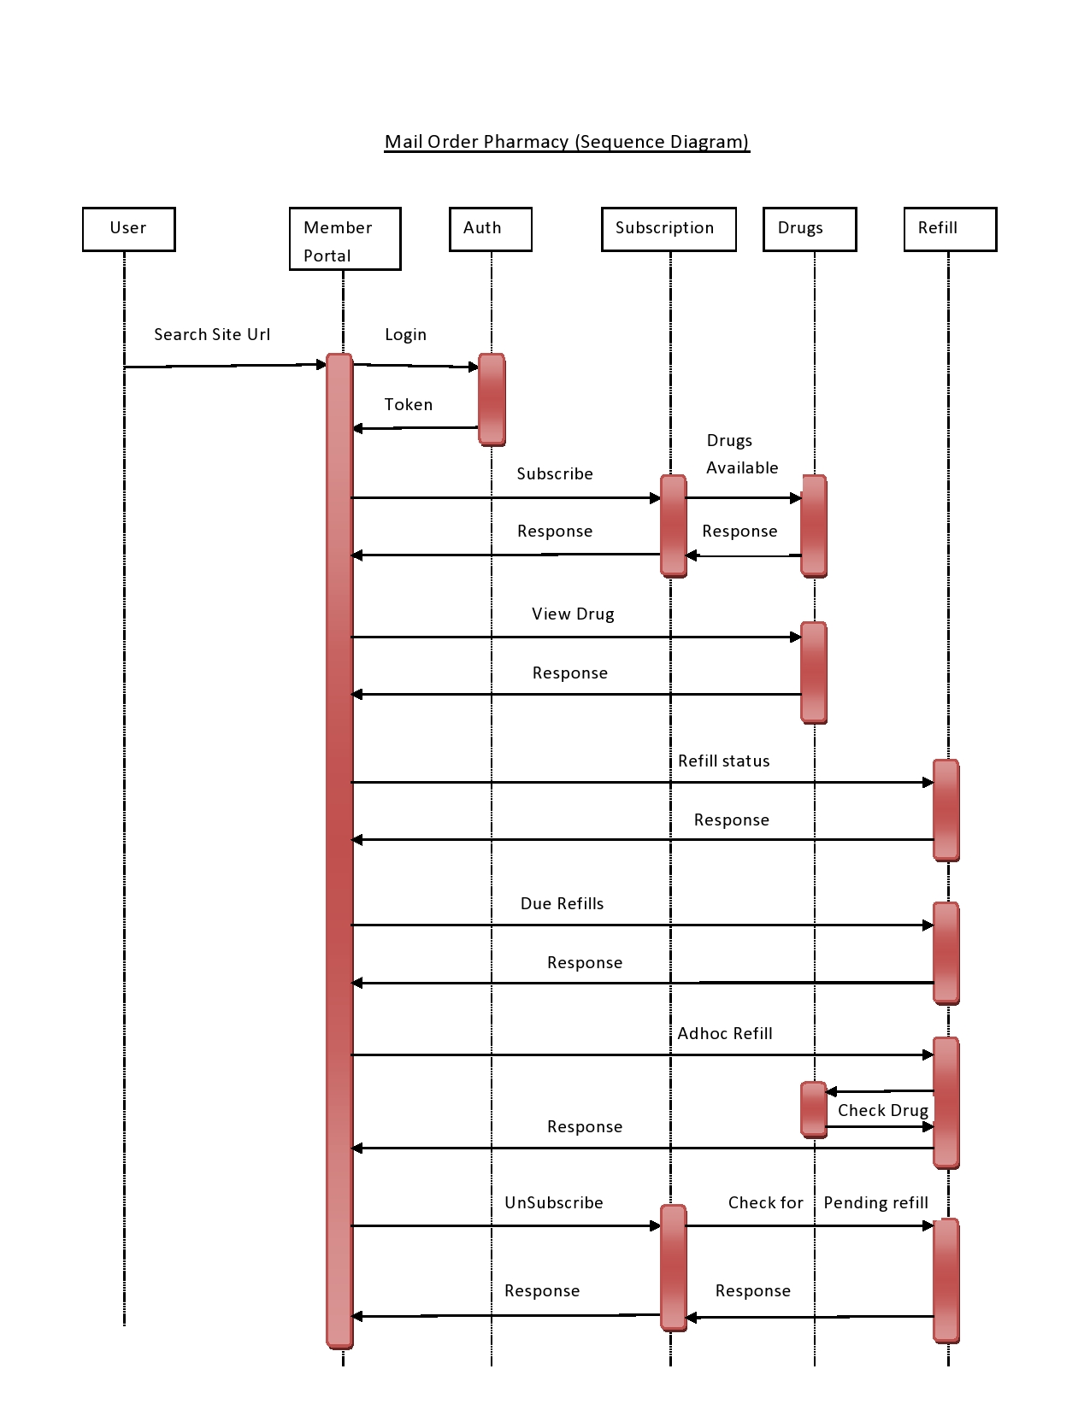

Slide 6
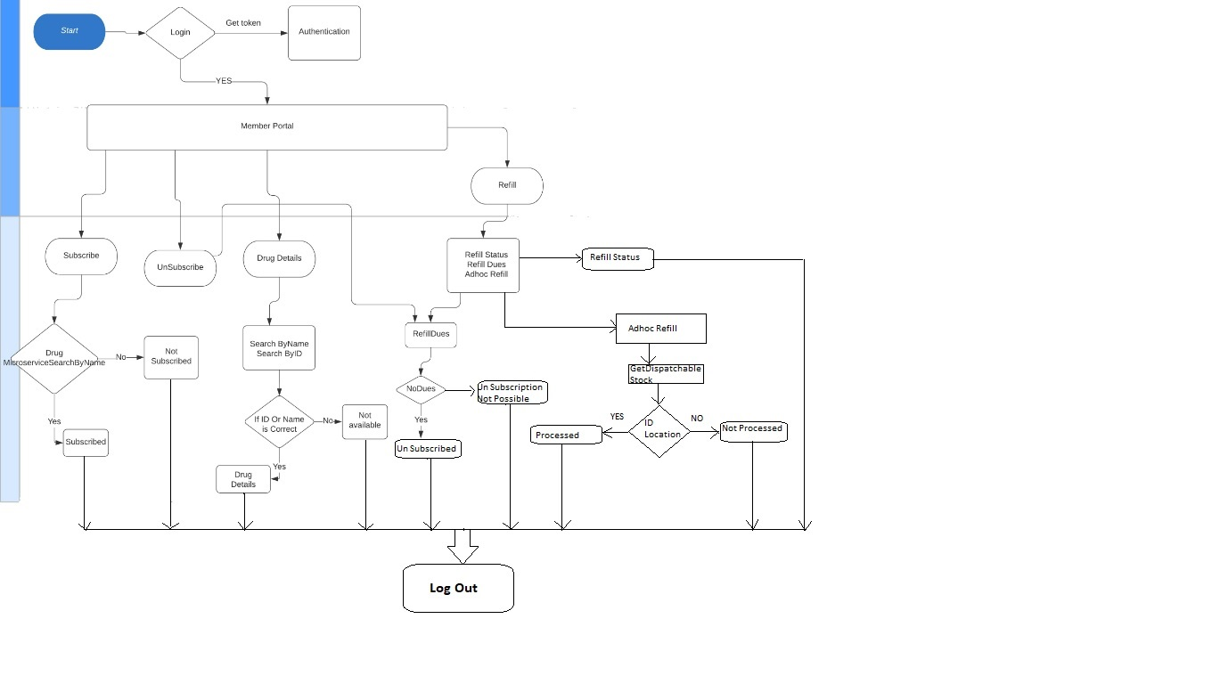
Flow Diagram

Slide 7
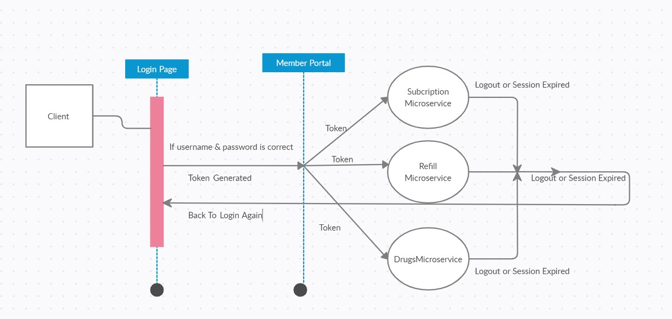
Sequence Diagram
Authorization Microservice

Slide 8
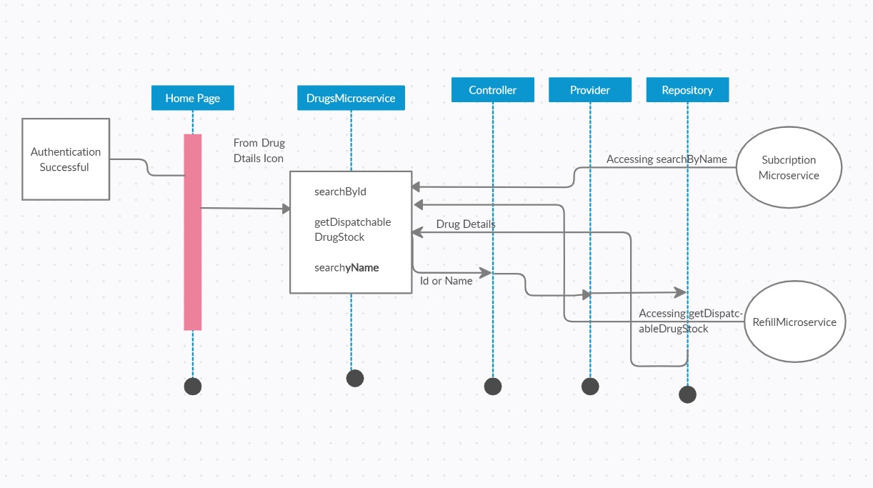
Sequence Diagram
Drugs Microservice

Slide 9
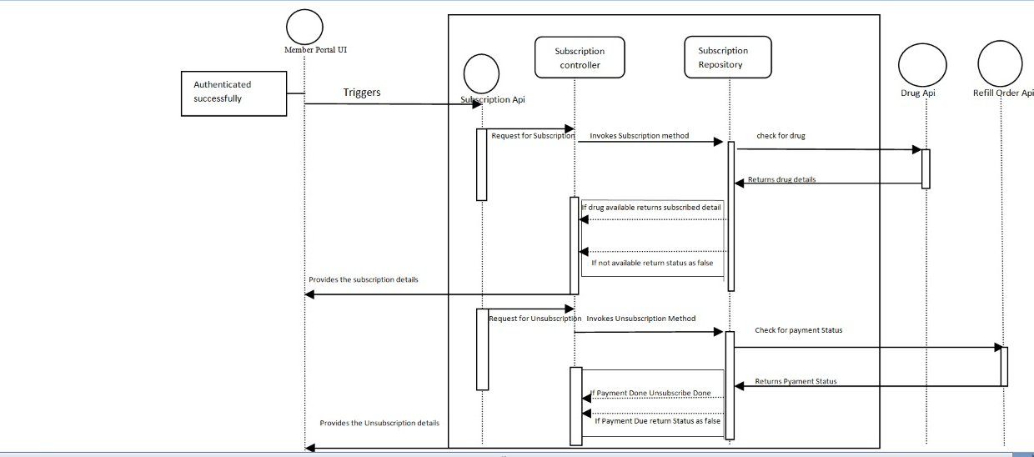
Sequence Diagram
Subscription Microservice

Slide 10
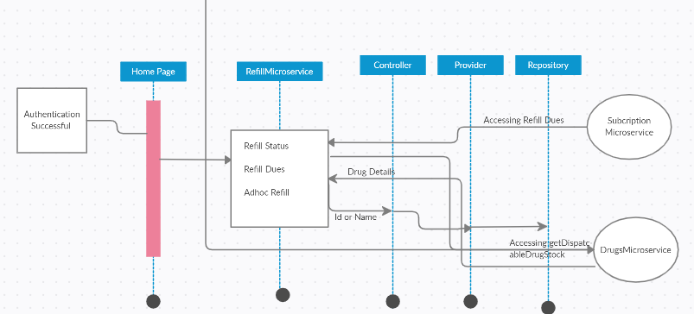
Sequence Diagram
Refill Microservice

Slide 11
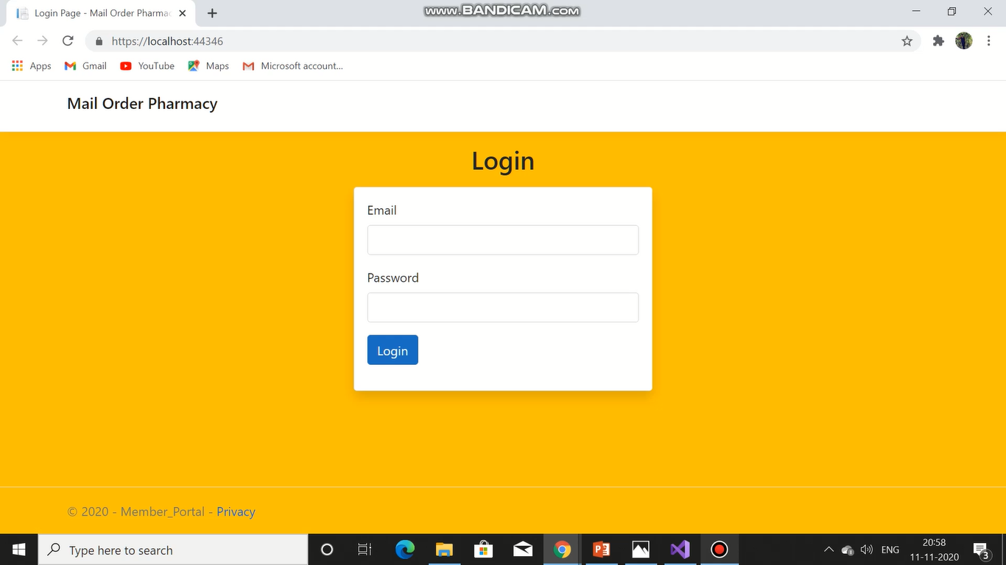

Slide 12
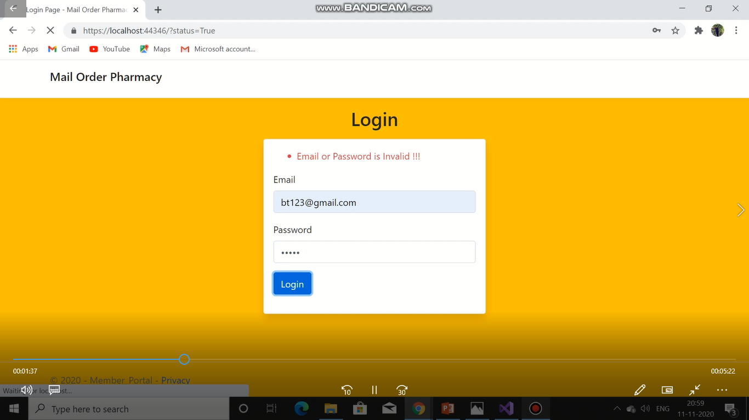

Slide 13
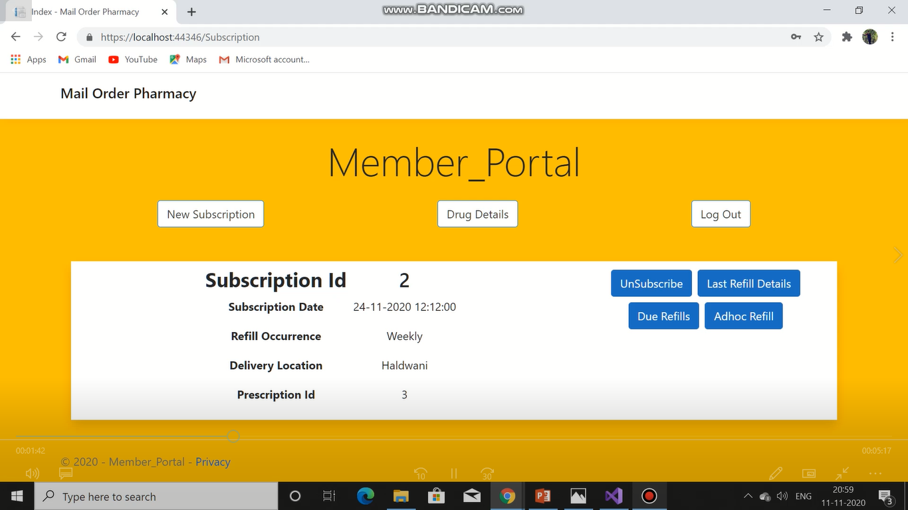

Slide 14
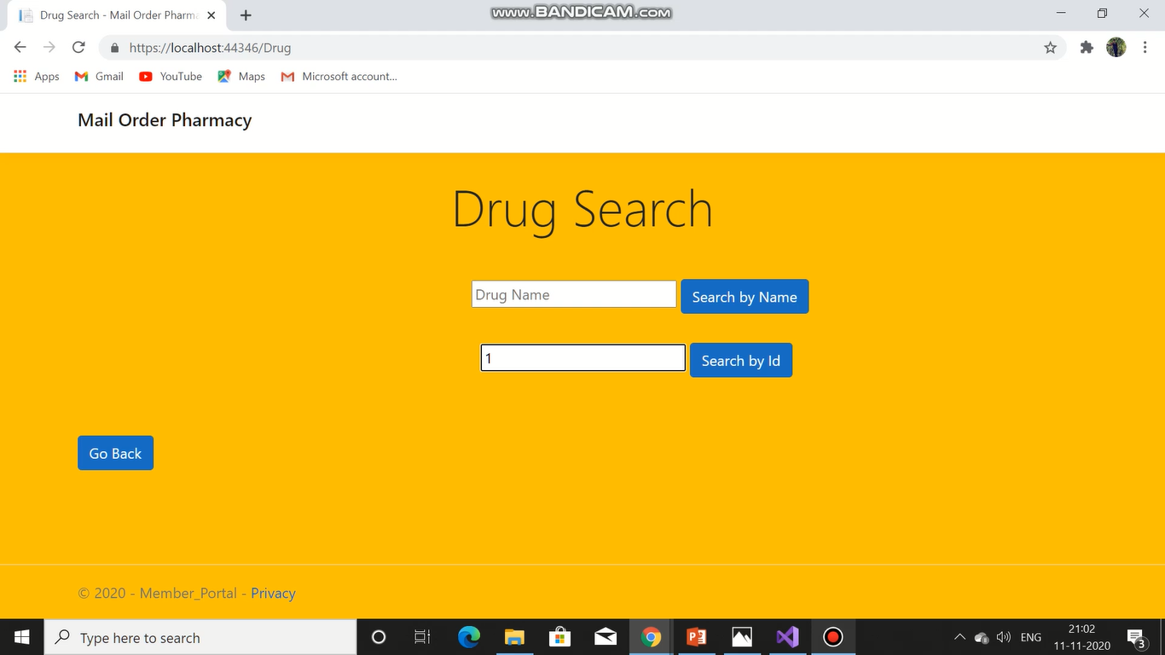

Slide 15
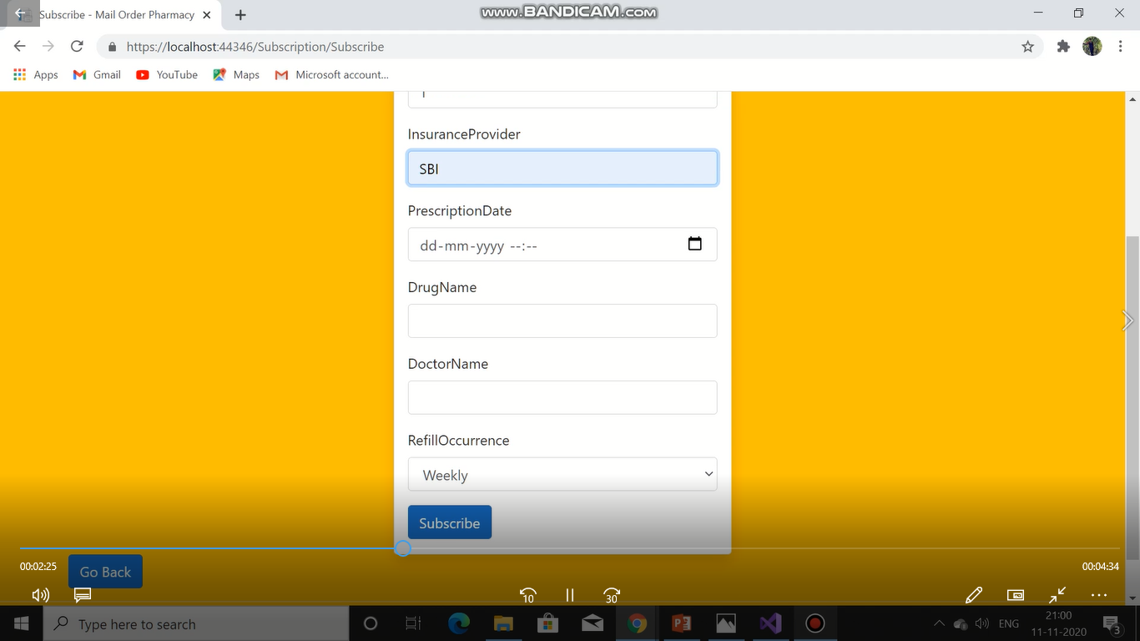

Slide 16
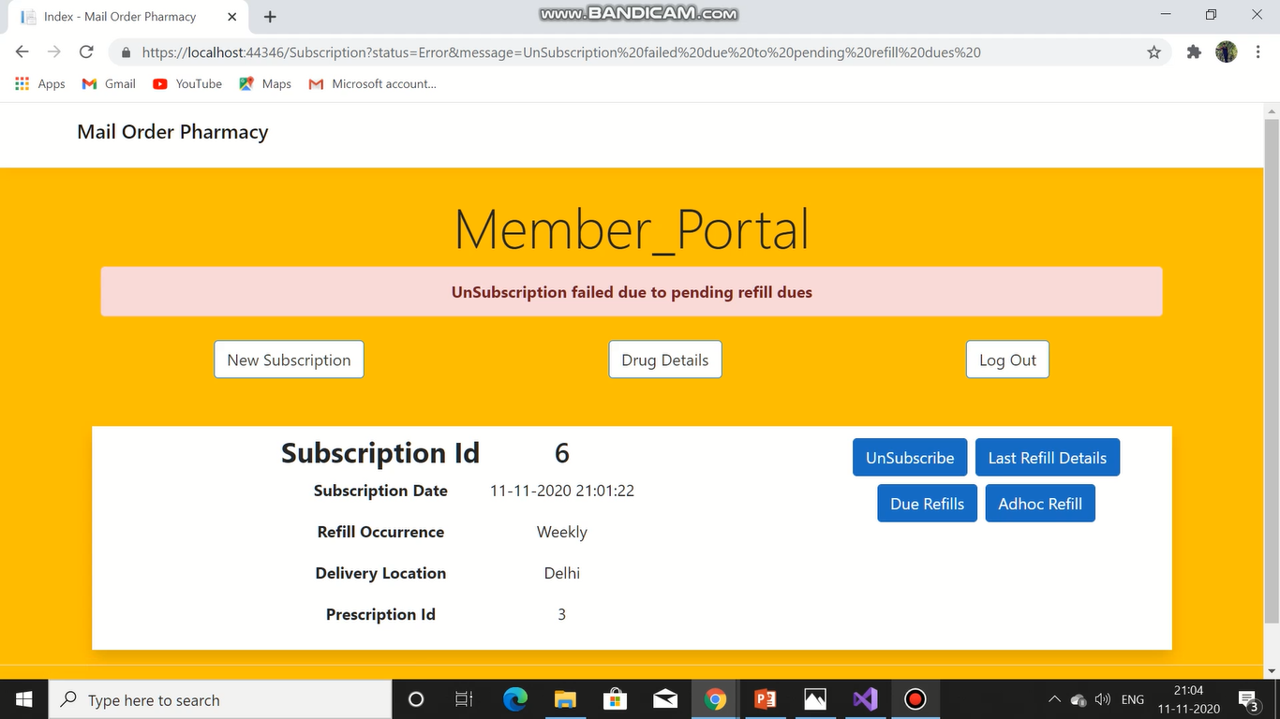

Slide 17
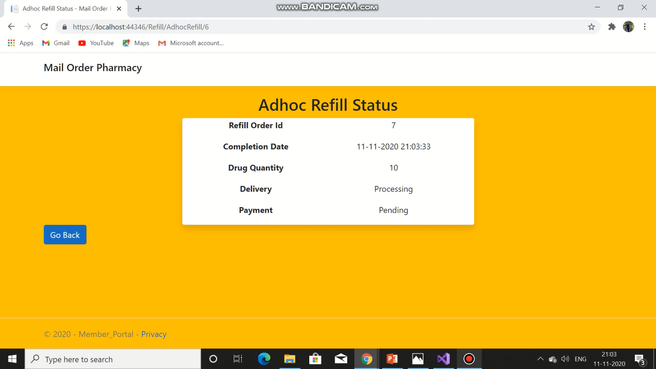

Slide 18
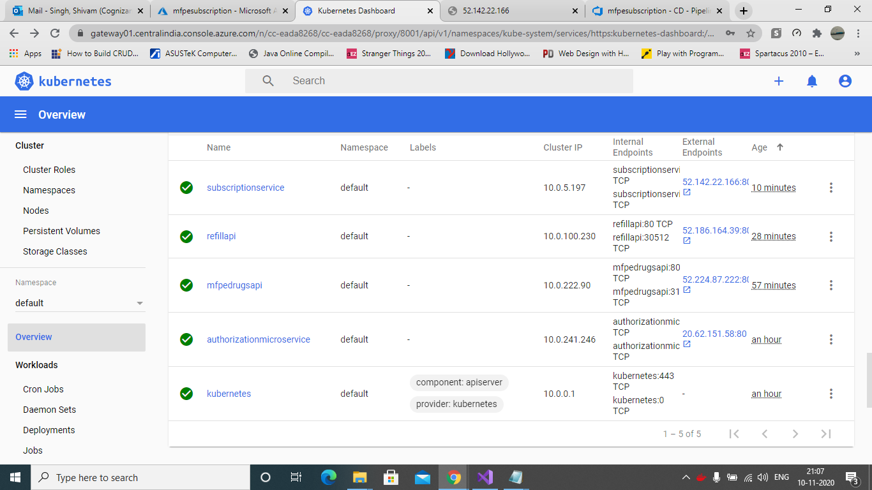

Slide 19
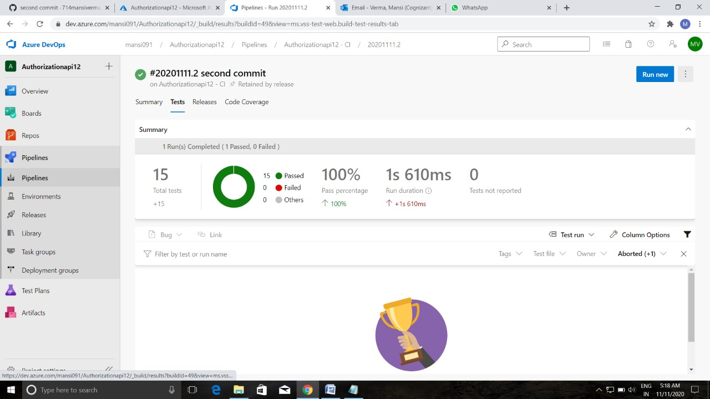

Slide 20
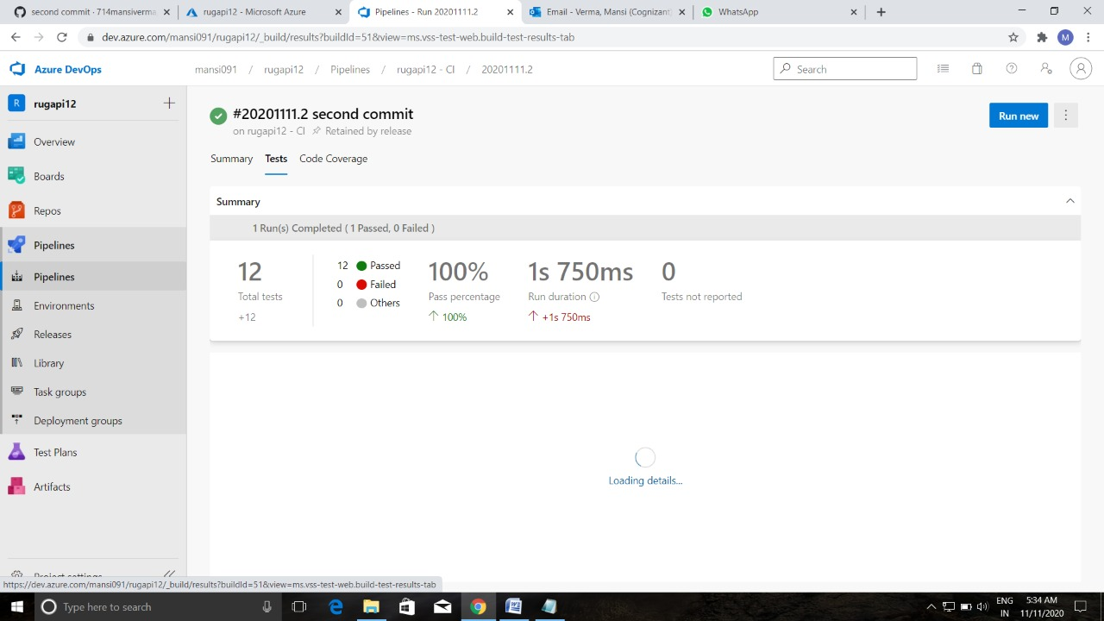

Slide 21


Slide 22
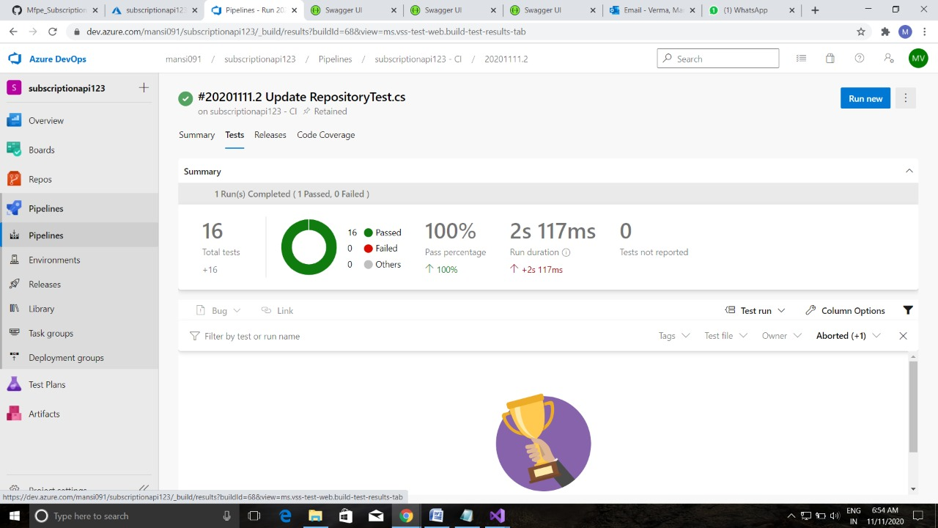

Slide 23
Group takeaways
How to work on a version control system as a team.
How designing of workflow and sequence diagram makes coding easier.
How discussion about any problem with teams and seniors gives different working solution.
How to work in group projects without meeting each other in this pandemic situation.

Slide 24
What could have been done better?
We could have worked more on UI design for more user friendly and seamless experience.
If we worked on database instead of in memory repository then we could have implemented the relations between microservices more perfectly.
If this project was done in office ambience then we could interact more often with seniors and among ourselves then we could have improved our social and technical knowledge more.

Slide 25
Conclusion
By doing this project we learnt how to study use case document , how to divide works in groups and help each other in their problems.
It also improved our knowledge of Microservices , C# concepts, EF core, coding standards and naming conventions, .Net core web api , MVC core and Nunit testing.
We also learn deploy microservices on cloud using Microsoft Azure and how to edit the CI/CD pipeline.
We had a great learning experience while doing this project and it will hopefully help us in future.

Slide 26
Thankyou.

